Slide 1



WORLD of INNOVATION in ZÜRICH
LE SALON FRANÇAIS, BAUR AU LAC
TALSTRASSE 1, 8001
ZÜRICH, SWITZERLAND
SEPTEMBER 27, 2024 – (FRIDAY)
REGISTRATION STARTS: 10:00
COFFEE MORNING RECEPTION: 10:15
PROGRAM: 11:00-16:00
COCKTAILS RECEPTION: 16:00 - 18:00
www.theabrahamicbusinesscircle.com

Slide 2

ECONOMIC DIPLOMACY
promoted through
BUSINESS and INVESTMENTS
The Abrahamic Business Circle is a prestigious global network dedicated to advancing economic diplomacy through business and strategic investments. Our members include entrepreneurs, investors, corporates, and diplomats spanning 56 countries, showcasing how entrepreneurial spirit and global investments can drive sustainable development worldwide.
Established prior to the Abraham Accords in September 2020, our Circle is committed to fostering unity and dialogue through economic collaboration.
We uphold core values of integrity, mutual respect, and collaboration, fostering a trusted network through quarterly meetings and events that drive economic growth, nurture entrepreneurship, and advocate for global progress. The Abrahamic Business Circle is strictly apolitical and areligious, focusing exclusively on tolerance and business.
As a community of visionaries, we believe in the transformative power of collective action and relentless pursuit of excellence to shape a future characterized by shared prosperity and innovation.
2
www.theabrahamicbusinesscircle.com

Slide 3
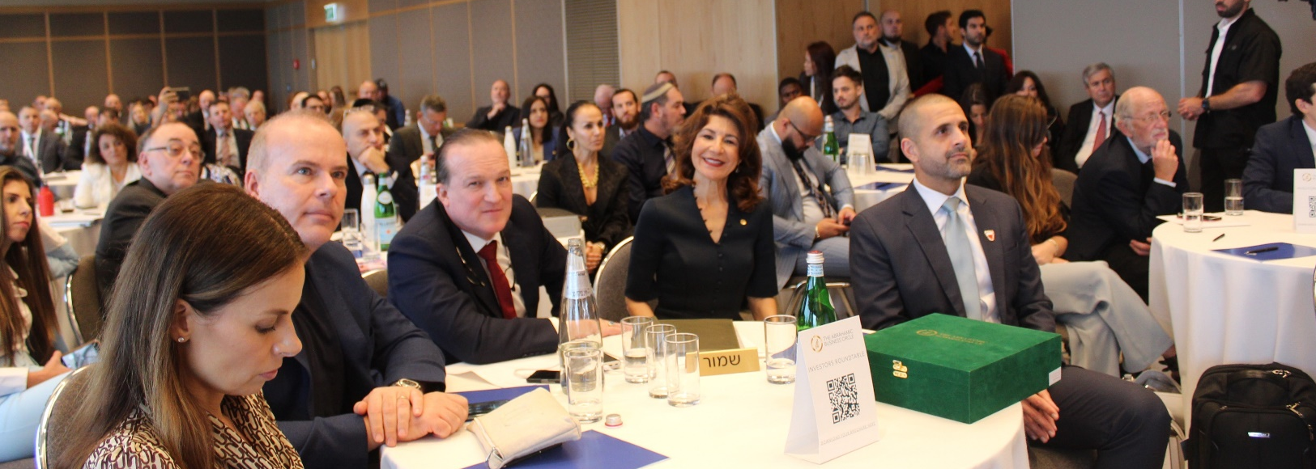
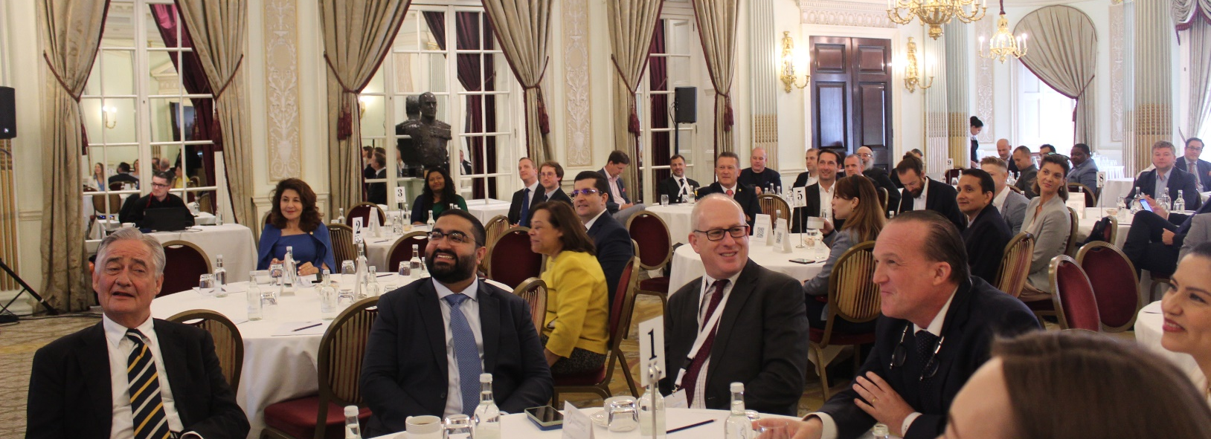
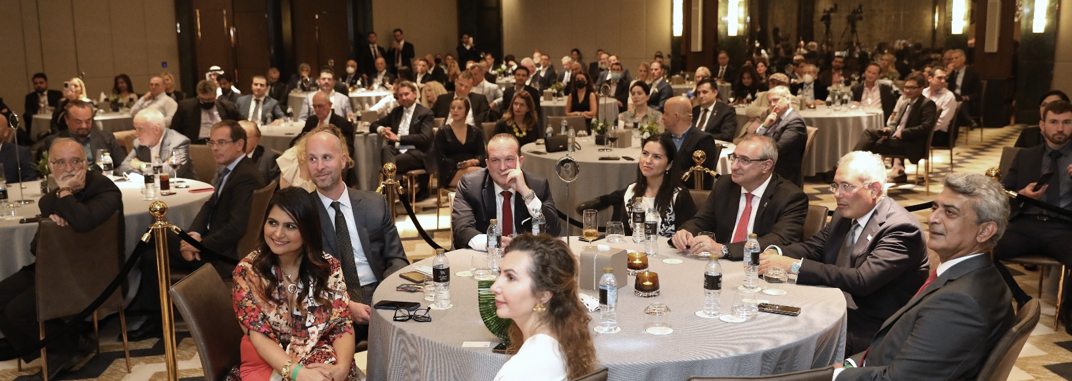
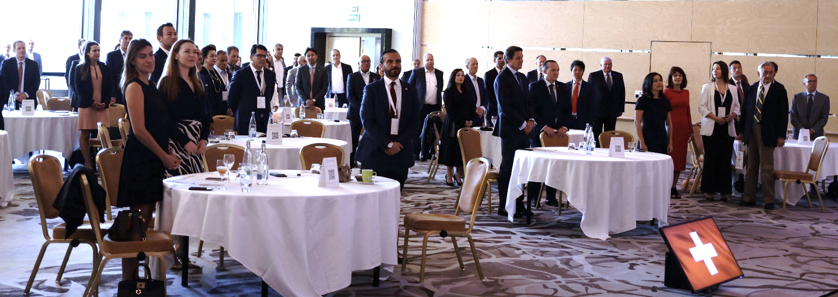
Some of the Previous Distinguished Guests and Speakers…

Slide 4

WORLD OF INNOVATION
by The Abrahamic Business Circle
Purpose of the Event:
World of Innovation event is a significant business gathering for our global members, offering direct access to cutting-edge ideas and high-impact projects. It provides valuable insights from industry leaders and fosters strategic networking opportunities, enabling members to forge new partnerships and explore investment prospects. By participating, members can enhance their knowledge, expand their global network, and drive collaborative innovation in an interconnected business environment.
Key Points:
The program is designed with ample networking opportunities strategically placed to foster meaningful connections and keep energy levels high.
Each segment of the program has a clear strategic purpose, aimed at driving innovation, collaboration, and actionable outcomes.
The event balances content delivery with interaction, ensuring that participants leave with both new knowledge and valuable new contacts.
Overview of the Day:
AGENDA
10:00 | REGISTRATION / PRE-NETWORKING MORNING COFFEE RECEPTIONS This early networking session sets the stage for the day, allowing participants to make initial connections in a relaxed atmosphere.
11:00 | PROGRAM STARTS | MASTERS OF CEREMONY: ALIONA ZALESKAYA DIRECTOR WETEL WORLD UAE | WETEL TV INFO UAE & ELI OVITS FOUNDER & LEAD CONSULTANT - ALTRUISTS | AMBASSADOR – THE ABRAHAMIC BUSINESS CIRCLE
11:10 | "SWISS PSALM" THE NATIONAL ANTHEM OF SWITZERLAND
11:15 | WELCOME ADDRESS | DR. RAPHAEL NAGEL (LL.M.) FOUNDER AND CHAIRMAN OF THE BOARD - THE ABRAHAMIC BUSINESS CIRCLE FOUNDING PARTNER AT TACTICAL MANAGEMENT
11:20 | INTRODUCTION OF THE PROGRAM Provide an overview of the agenda, emphasizing key themes and encouraging active participation | DR. TILLMANN LAUK (LL.M.) CO-FOUNDER AND CHAIRMAN OF THE BOARD - THE ABRAHAMIC BUSINESS CIRCLE CHIEF EXECUTIVE OFFICER - E-MILLENNIUM-1 VERWALTUNG GMBH
11:25 | 15-MINUTES INTRODUCTION OF ATTENDEES SESSION (FIRST HALF) Allow each attendee a brief introduction, fostering a sense of community and helping participants identify potential connections early.
11:45 | SPECIAL ADDRESS | HIS EXCELLENCY MR. BERNARD FAUSTINO LA MADRID DY AMBASSADOR OF PHILIPPINES TO SWITZERLAND
12:00 | SPECIAL ADDRESS | HER EXCELLENCY DR. IRYNA VALENTYNIVNA VENEDIKTOVA AMBASSADOR OF UKRAINE TO SWITZERLAND AND LIECHTENSTEIN
12:15 | 15-MINUTES NETWORKING BREAK A brief break to discuss the morning’s insights and start forming deeper connections.
12:30 | SPECIAL ADDRESS | CONSUL GENERAL MR. MARIO GIORGIO STEFANO BALDI CONSULATE GENERAL OF ITALY IN ZURICH
12:45 | KEYNOTE ADDRESS: 9 Disruptive Trends Unleashed by Artificial Intelligence | ERIC JACKSON AUTHOR OF "THE PAYPAL WARS“ ANGEL INVESTOR | STRATEGIC ADVISOR
13:00 | 1-HOUR NETWORKING LUNCH Encourage attendees to have meaningful conversations over lunch, facilitating deeper discussions and potential collaborations.
14:00 | 15-MINUTES INTRODUCTION OF ATTENDEES SESSION (SECOND HALF) Provide another opportunity for attendees to introduce themselves, ensuring everyone gets a chance to be recognized and connected.
14:15 | KEYNOTE PRESENTATION: “Waste is Raw Material at the Wrong Place” How to Seize the Opportunity and Turn Recycling into a Profitable Business | THOMAS BALDT GENERAL MANAGER - EXPERT4RECYCLING
14:30 | KEYNOTE PRESENTATION: SIMPEGO - Innovating Swiss Insurance with a Flexible Business Model | DR. PATRICK EUGSTER CHIEF EXECUTIVE OFFICER - SIMPEGO INSURANCE LTD.
14:45 | AFTERNOON NETWORKING COFFEE BREAK A key networking session designed to keep energy levels high and allow for reflection on the keynote presentations.
15:15 | KEYNOTE PRESENTATION: SPSA NextGen & Lifestyle Campus | PEGGY SEFOLOSHA BUSINESS DEVELOPMENT SWISS PREPARATORY SPORT ACADEMY NBA BASKETBALL SCHOOL ZURICH
15:30 | OPEN FORUM: DUBAI: Pioneering Innovation and Real Estate Investment | JAN GUSTAV KUBLER CEO & FOUNDING PARTNER – WORLDFIELD INVESTMENT HOLDING LTD.
15:45 | CLOSING SESSION Summarize the key takeaways of the day, encourage ongoing collaboration, and set the tone for future engagements
16:00 | 2-HOURS POST-NETWORKING COCKTAILS RECEPTION Provide a relaxed environment for attendees to solidify connections made throughout the day and explore potential collaborations in a more informal setting.
4
www.theabrahamicbusinesscircle.com

Slide 5






PARTNERS & SPONSORS
5
www.theabrahamicbusinesscircle.com

Slide 6








PARTNERS & SPONSORS
6
www.theabrahamicbusinesscircle.com

Slide 7


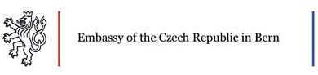





SPECIAL THANKS TO:
FOSTERING
ECONOMIC DIPLOMACY
through
BUSINESS and INVESTMENTS
7
www.theabrahamicbusinesscircle.com

Slide 8
The Abrahamic Business Circle Ecosystem has Individuals who work or have worked at :
•3DC Inc
•5Y Capital
•9606 Capital
•Abdulla Al Gurg Global Investments
•Abu Dhabi Islamic Bank
•Abundy Inc.
•ADGM
•Advanced Technology Fund (ATF)
•Advantage Family Office
•Advisor H.H. Sheikh Marwan bin Mohammed Al Maktoum
•Advisor Sheikh Ahmad Bin Obaid Al Maktoum International Investments Enterprises at BRICU
•AGBI Real Assets
•AIX Investment Group
•AJG Holding
•Akin Gump Strauss Hauer & Feld LLP
•Al Ali Holding
•Al Ashram Contracting LLC
•Al Habtoor Group
•Al Naboodah Travel & Tourism Agencies LLC
•Al Nokhba Group
•Al Zahra Hospital
•Alfa Property Group Ltd
•Ali Mousa Holding
•Altruists
•Amanet Management & Systems Ltd
•Ameria AG
•American Jewish Committee (AJC)
•Ankaa Ventures
•Annex Investments
•Anglo-Gulf Trade Bank
•AozoraStep Capital LLP
•AQVC
•Arian Lev Centers
•Arklight Consulting Group
•Artemis Group
•Artportal Immobilien & Dienstleistungs GmbH
•Artukbey Kahvi
•Ashbourne Day Nurseries Ltd
•AT&T
•Ava Biodefender
•Azamra Capital LLC
•Azizi Developments
•Bank of America Merrill Lynch
•Bank of China
•Basin Lake Capital
•BBVA Group
•beable
•Beit Berl College
•Ben-Gurion University
•Bitkern Group
•Blackstone Group
•Bloomberg HTTV
•Blue Valley Middle East Investment LLC
•Blumberg Capital
•Boston Consulting Group, BCG
•CaixaBank
•Calaya Engineering Services LTD
•California State University
•Callamus
•Capital Nature
•Charles Russell Speechlys
•China Construction Bank
•China Gravy Inc.
•cisco
•Citi Group
•Cohiba Minerals LTD
•Context Global Advance Tech
•Corundum Open Innovation
•CPS Group
•Credit Suisse
•CryptoLaw Partners
•Cuatrecasas
•Cybergym
•DAFZA
•Daigle Labs
•Daman Investments
•Davensi
•Dayholi GmbH
•DBR Capital
•Deep Blue Equity
•Demira Gate Investments
•Deutsche Bank
•DHL
•District 5 Boutique
•DMCC
•Donne Investments
•Dhruva Consulatants
•Dubai Chamber of Commerce
•Dubai Islamic Bank
•EBN&Co
•El Correo del Golfo
•Elsmed Healthcare
•Emaar Properties PJSC
•Embassy Capital Group LLC
•Emirates
•Emminence Real Estate
•esade
•European Women’s Association (EWA)
•Evergrowth Biohealthcare Capital LLC
•Experts4Recycling GmbH
•ExxonMobil
•Fieldfisher Spain
•Food & Nutrition Group
•Fourstar EC Investments
•Franklin Templeton Investments
•Freidberg Economic Institute
•FRM Member Swiss Parliament
•FRM Member UK Parliament
•GCC International
•Gelicail
•Genxell Corporations PTY Ltd
•Global Asset Portfolio Ltd
•GlobeInvest Ventures
•GMH-Ventures
•GVI Gold Ventures Investment
•grovana EG
•Guild Capital Partners Ltd
•Gulf Analytica
•H Capital Ventures Ltd
•Hadassah Hospital at the Hebrew University of Jerusalem
•Hamdan AlShamsi Lawyers& Legal Consultancy
•Hazels Mountain Capital
•Healthcare Planning Department of Health Abu Dhabi
•HechicerIA
•Hercules Holdings
•Herzliya Medical Center
•Herzog Fox & Neeman Law Firm
•HPQ Silicon
•Humanity Investments International LLC
•i24News
•IFZA
•Impact Business Investment Group
•IMPACT-SE
•IncluSIF Social Capital
•Indicator Global Inc. (Shanghai Operation Center)
•International Center for Endoscopic Spine Surgery
•Institute for Transformational Development (ITD)
•Integral Petroleum
•intel
•Intel Capital
•International Christian Embassy Jerusalem
•interpolitan Money
•Investec
•Israeli Prime Minister's Office
•ITP Media Group
•ITD
•Jaico & Herrero Consulting Group
•Jiliti Austria GmbH
•Jerusalem Post
•JJH Law Consulting Oy
•Johnson & Johnson
•JPMorgan Chase & Co.
•Jumeirah International
•Junior Chamber International Russia
•She
•Key Africa Ltd
•KCP Capital
•Khaleej Times
•Knuru Capital
•Latitude Consultancy Limited
•LEAD Ventures Project Management Services LLC
•Lightspeed Venture Partners
•Lukoil
•Luxan Capital
•Maryland University
•MBM Maktoum Investments
•Mediapix
•Medical Network Switzerland
•Merck
•Metro AG
•Microsoft Startup
•Middle East Interpolitan Money
•Money Power Consultants LLP
•MRM Family (Europe & Asia)
•MyEloid Therapeutics
•Myra Group
•Nagel & Partners
•Nakheel Group
•National Bank of Fujairah
•Natural Ventures
•Nestle
•Netflix
•New Value Group
•Newfields Group
•Ocean Harvest
•One Swiss Bank
•Onion Education
•Openspring
•Oracle
•Orion Health
•Our Limited Planet
•Paris Metropolitan University
•PepsiCo
•Petrobras Singapore Pte Ltd
•Pfiezer
•Pharmax Pharmaceuticals FZ LLC
•PIMCO Investments LLC
•PLL Legal & Cross-Border Practice
•Pommery Foundation
•PressLink Media
•Private Office of Sheikh Mohamed Bin Ahmed Bin Hamadan Al Nahyan
•PwC
•PyH Global Services Holding
•Quarero Martketing Accellerator
•Quarero Robotics
•Raibal Holdings
•RAKEZ
•Real Davis Group
•Remax
•Revolut
•Rimon PC
•Roche Group
•ROGG Gesunde Innovation
•Roubini Macro Associate LLC
•S.A.L.P. Middle East
•Samsung
•Santander Bank
•Save A Child’s Heart
•Sawadi Ventures
•Schneider Children's Medical Center of Israel
•Scientel
•Sett & Lucas
•Sequoia Capital
•Sertecpet
•Shell
•Siegel Group
•Silver Road Capital Group
•SJM Group
•Softbank Group
•Sokotra Capital
•soonami.io GmbH
•SP Jain School of Global Management
•Squire Patton Boggs
•Stree Group
•Strohal Legal Group
•Strolla Limited and Strolla LLP
•Swiss Federal Department of Foreign Affairs
•Swiss Finance & Technology Association
•Syria Recovery Trust Fund (SRTF)
•Tactical Management DWC
•Tamas Projects
•Tanaruz Boats
•TASC Consulting & Capital
•Taskforce Solutions
•Tech Talk Media
•Tembo Power Holdings
•Teroxx Investment GmbH
•Terreus Capital AG
•The Prince of Bismarck
•Thompson Family Office
•Todolivo S.L.
•Toledo Capital AG
•Touro University Berlin
•Toyota
•Tradeluxe LTD
•Trisolar
•TSMC
•UAE-UK Business Council
•Ubank
•UBS Group
•UDIMA University
•UEMC
•UniCredit
•UNIPASS
•United Foods Company
•Vondellaan Vastgoed
Beheer B.V.
•Vattenfall AB
•Velis Media Group
•Verizon
•Volkswagen
•VP Bank (Schweiz) AG
•Wahyd Group
•Wake Engineering
•Water 4 Mercy
•Waterfall Security Solutions
•Warszawa Stock Exchange
•WeFund
•Wells Fargo
•Weltethos Institute
•WeTel UAE
•White & Case
•WION
•Woodville Litigation Funding
•Worldfield Investment Holding Ltd
•Xioma Automotive Solutions
•Yieldstreet
•Yungo Legal
•Zell and Aron
•ZOHO Corporation
•And Many More...
8
www.theabrahamicbusinesscircle.com

Slide 9

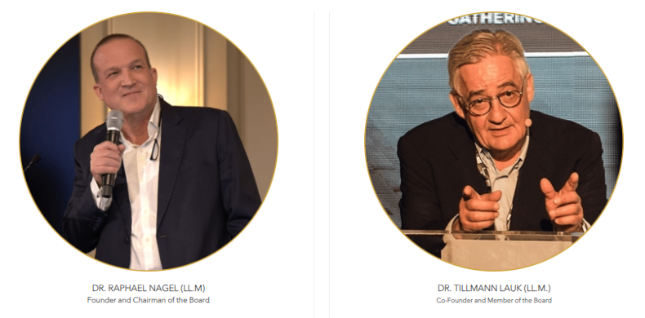
MESSAGE FROM THE FOUNDERS
We live in a world where division and conflict often overshadow the vital need for dialogue. Now, more than ever, conversations that bridge divides and foster a brighter future are essential. This is where the Abrahamic Business Circle steps in. Our organization is apolitical and areligious, dedicated solely to business, trade, and investment—a practice we proudly term economic diplomacy.
The Abrahamic Business Circle transcends geographical boundaries, with a vibrant presence not only in the Middle East but also in Europe and Asia. Our members hail from every corner of the globe, representing diverse nations and backgrounds. What unites us is a shared commitment to fostering economic prosperity for all. We believe that economic prosperity is a cornerstone for achieving peace, bridging political, religious, and ideological divides.
The foresight we had in founding The Abrahamic Business Circle four years ago is more relevant today than ever. In these exciting times, dialogue among different peoples is essential. We extend our heartfelt gratitude to all our members, sponsors, and guests for their unwavering dedication to these goals. Together, we are creating a future where peace and prosperity thrive for everyone.”
9
www.theabrahamicbusinesscircle.com

Slide 10


TOLERANCE IS THE KEY
BE A PART OF THE CIRCLE
contact@theabrahamicbusinesscircle.com
For Membership & Sponsorship:
+971 54 498 4350 | +971 50 865 3204
www.theabrahamicbusinesscircle.com

